Slide 1
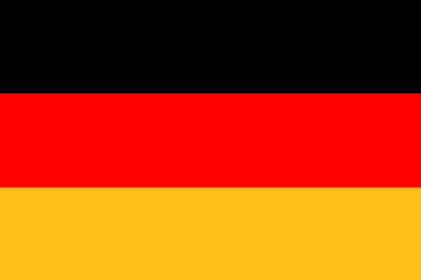
Germany

Slide 2
Facts about Germany
Official language German
Capital Berlin
Form of government Parliamentary Federal Republic
Head of state President Joachim Gauck
Prime Minister Chancellor Angela Merkel
Area 357.111,91 km²
Population 81,751 Mio
Population density 229 km ²
Federal States 16

Slide 4
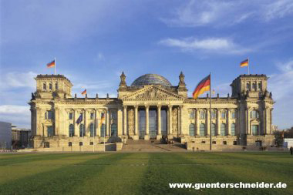
Attractions
Berlin
The Brandenburg Gate
The Reichstag

Slide 5
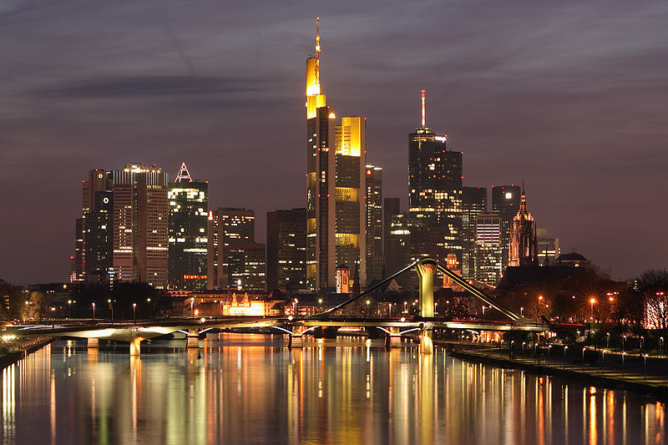
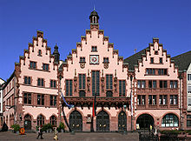
Frankfurt
Frankfurt Airport is one of the world's busiest international airports, Frankfurt Central Station is one of the largest terminal stations in Europe, and the Frankfurter Kreuz is the most heavily used interchange in continental Europe. Frankfurt is the only German city listed as one of ten Alpha world cities. Frankfurt lies in the former American Occupation Zone of Germany, and it was formerly the headquarters city of the U.S. Army in Germany.

Slide 6
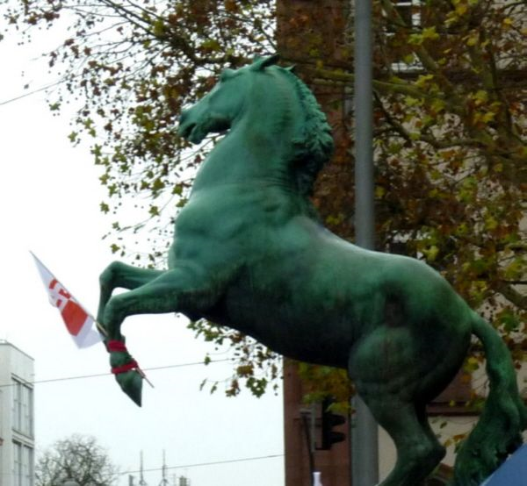
Gießen
The name comes from Giezzen, as it was first referred to in 1197, which refers to the position of the town between several rivers, lakes and streams. The largest river in Gießen is the Lahn, which divides the town in two parts (west and east), roughly 50 kilometres north of Frankfurt am Main.

Slide 7
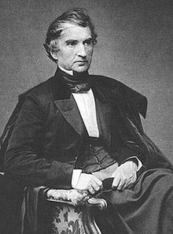
Famous people from Germany
Justus Liebig
Justus von Liebig (12 May 1803 – 18 April 1873) was a German chemist who made major contributions to agricultural and biological chemistry, and worked on the organization of organic chemistry. As a professor, he devised the modern laboratory-oriented teaching method, and for such innovations, he is regarded as one of the greatest chemistry teachers of all time.
He is known as the "father of the fertilizer industry" for his discovery of nitrogen as an essential plant nutrient, and his formulation of the Law of the Minimum which described the effect of individual nutrients on crops. He later recanted his views on the efficacy of chemical fertilizers. He also developed a manufacturing process for beef extracts, and founded a company, Liebig Extract of Meat Company, that later trademarked the Oxo brand beef bouillon cube.

Slide 8
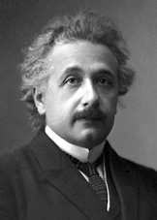
Albert Einstein
Albert Einstein (pronounced German 14 March 1879 – 18 April 1955) was a theoretical physicist, philosopher and author who is widely regarded as one of the most influential and iconic scientists and intellectuals of all time. A German-Swiss Nobel laureate, Einstein is often regarded as the father of modern physics.^{[2]} He received the 1921 Nobel Prize in Physics "for his services to theoretical physics, and especially for his disNear the beginning of his career, Einstein thought that Newtonian mechanics was no longer enough to reconcile the laws of classical mechanics with the laws of the electromagnetic field. This led to the development of his special theory of relativity. He realized, however, that the principle of relativity could also be extended to gravitational fields, and with his subsequent theory of gravitation in 1916, he published a paper on the general theory of relativity. He continued to deal with problems of statistical mechanics and quantum theory, which led to his explanations of particle theory and the motion of molecules. He also investigated the thermal properties of light which laid the foundation of the photon theory of light. In 1917, Einstein applied the general theory of relativity to model the structure of the universe as a whole.covery of the law of the photoelectric effect"

Slide 9
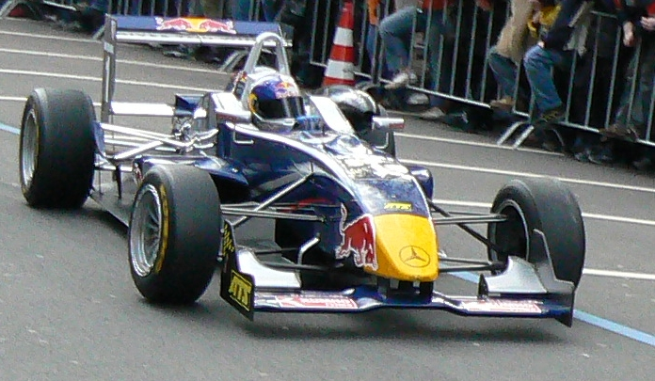
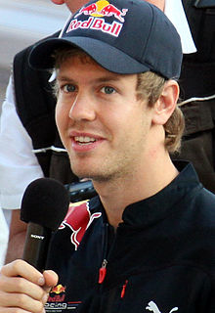
Germany‘s best Athlets
Sebastian Vettel
is a German Formula One racing driver, currently driving for Red Bull Racing
He is the current World Champion, having won in the 2010 season. In the same year he, along with teammate Mark Webber, helped Red Bull win the World Constructors' Championship.

Slide 10
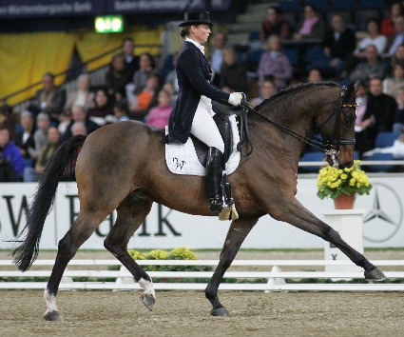
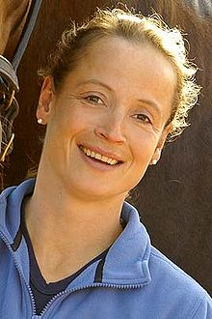
Germany‘s best female Athlet
Isabell Werth
Werth has competed in the Olympics four times in 1992, 1996, 2000 and 2008. In
those four games she won eight medals, five of them gold. Werth has also won
seven Dressage World Championship medals, six of them gold. She has competed
multiple times at the European Dressage Championships, earning several gold and
silver medals. At the 2008 Olympics she won the team championship together with
her colleagues Heike Kemmer and Nadine Capellmann. Isabell Werth worked
alongside Bates Australia to develop the Isabell Dressage Saddle available in Bates
and Wintec.

Slide 11
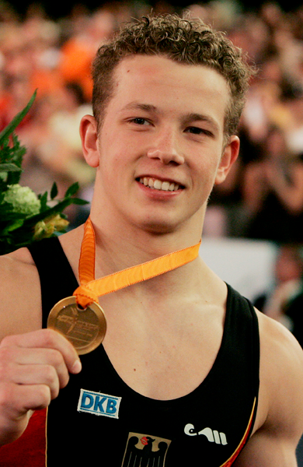
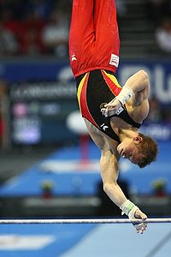
Germany‘s best gymnast
Fabian Hambüchen
(born October 25, 1987 in Bergisch Gladbach, North Rhine-Westphalia) is a German
gymnast. He lives in Wetzlar.
Hambüchen was the youngest German athlete at the 2004 Summer Olympics in Athens
and finished 7th in the Horizontal bar and 8th in the team competition. So far in his
career, he has won five medals at World Championships and six at European
Championships. At the 2008 Summer Olympics in Beijing, he won the bronze medal in
the men's high bar competition.
He was named male German sportsperson of the year 2007.
Hambüchen had to pull out of the 2009 World Artistic Gymnastics Championships
because of an injury to his foot. He was a frontrunner for the all around title and the
high bar.

Slide 12
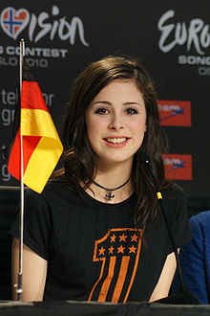
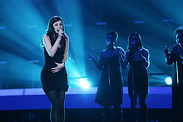
Musicstar
Lena Meyer-Landrut
Lena Meyer-Landrut , also known by her stage name Lena, is a German singer and songwriter. She represented Germany in the Eurovision Song Contest 2010 in Oslo, Norway, and won the contest with the song "Satellite“.With her three entries from the German national final Unser Star für Oslo (Our Star for Oslo), Meyer-Landrut set an all-time chart record in her home country by debuting with three songs in the top five of the German singles chart. Both "Satellite" and her first album My Cassette Player debuted at number one in Germany, and have been certified double Platinum since. It has been confirmed that Meyer-Landrut will once more represent Germany in the Eurovision Song Contest in 2011

Slide 13
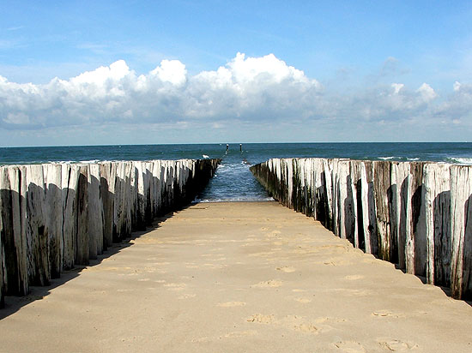
Landscapes
The North Sea is a marginal sea of the Atlantic Ocean located between Great Britain and Scandinavia. An epeiric (or "shelf") sea on the European continental shelf, it connects to the ocean through the English Channel in the south and the Norwegian Sea in the north. It is more than 970 kilometres long and 580 kilometres wide, with an area of around 750,000 square kilometres. The North Sea has long been the site of important European shipping lanes as well as a major fishery. The sea is a popular destination for recreation and tourism in bordering countries and more recently has developed into a rich source of energy resources including fossil fuels, wind, and early efforts in wave power.

Slide 14
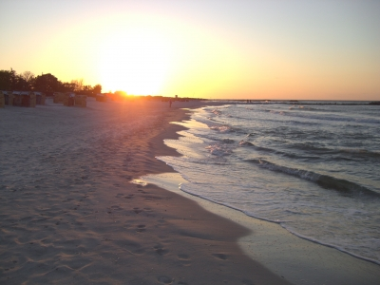
Landscapes
The Baltic Sea is a brackish mediteranean sea located in Northern Europe, from 53°N to 66°N latitude and from 20°E to 26°E longitude. It is bounded by the Scandinavian Peninsula, the mainland of Europe, and the Danish islands. It drains into the Kattegat by way of the Øresund, the Great Belt and the Little Belt. The Kattegat continues through Skagerrak into the North Sea and the Atlantic Ocean. The Baltic Sea is connected by man-made waterways to the White Sea via the White Sea Canal, and to the North Sea via the Kiel Canal. The Baltic Sea might be considered to be bordered on its northern edge by the Gulf of Bothnia, on its northeastern edge by the Gulf of Finland, and on its eastern edge by the Gulf of Riga. However, these various gulfs can be considered to be simply offshoots of the Baltic Sea, and therefore parts of it.

Slide 15
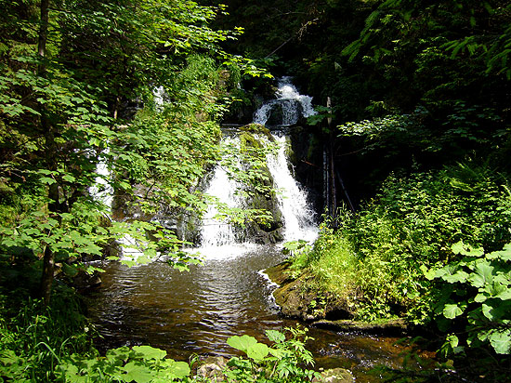
The Black Forest
The Black Forest (German: Schwarzwald) is a wooded mountain range in Baden-Württemberg, southwestern Germany. It is bordered by the Rhine valley to the west and south. The highest peak is the Feldberg with an elevation of 1,493 meters. The region is almost rectangular with a length of 200 km and breadth of 60 km. Hence it has an area of approximately 12,000 km². The name Schwarzwald, i.e. Black Forest, goes back to the Romans who referred to the thickly forested mountains there as Silva Nigra , i.e. "Black Forest," because the dense growth of conifers in the forest blocked out most of the light inside the forest.

Slide 16
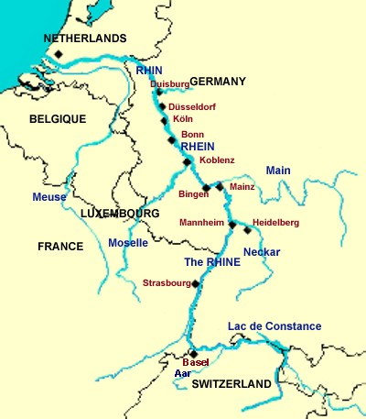
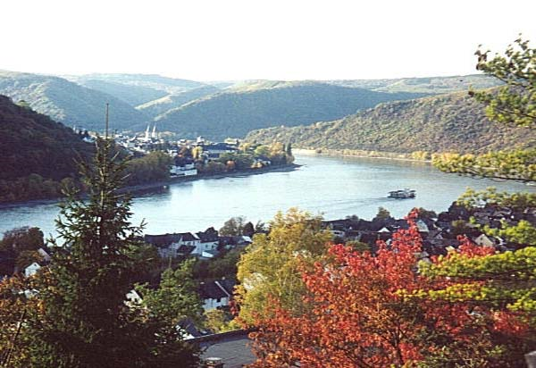
The river Rhine
The Rhine (German: Rhein) flows from the Swiss Alps to the Netherlands, and is one of the longest and most important rivers in Europe, at about 1,233 km, with an average discharge of more than 2,000 m³ The name of the Rhine derives from Gaulish Renos, and ultimately from the Proto-Indo-European root reie which is also the root of words like river and run. The Reno River in Italy shares the same etymology. The spelling with -h- seems to be borrowed from the Greek form of the name, Rhenos, seen also in rheos, stream, and rhein, to flow. The Rhine and the Danube formed most of the northern inland frontier of the Roman Empire and, since those days, the Rhine has been a vital and navigable waterway carrying trade and goods deep inland. It has also served as a defensive feature and has been the basis for regional and international borders. The many castles and prehistoric fortifications along the Rhine testify to its importance as a waterway. River traffic could be stopped at these locations, usually for the purpose of collecting tolls, by the state that controlled that portion of the river.

Slide 17
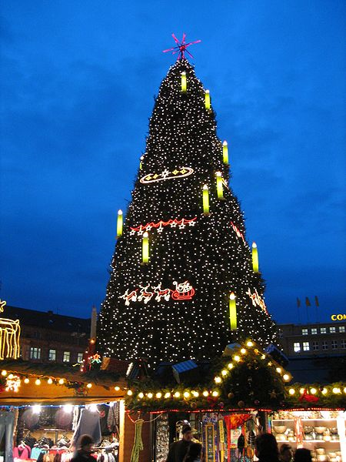
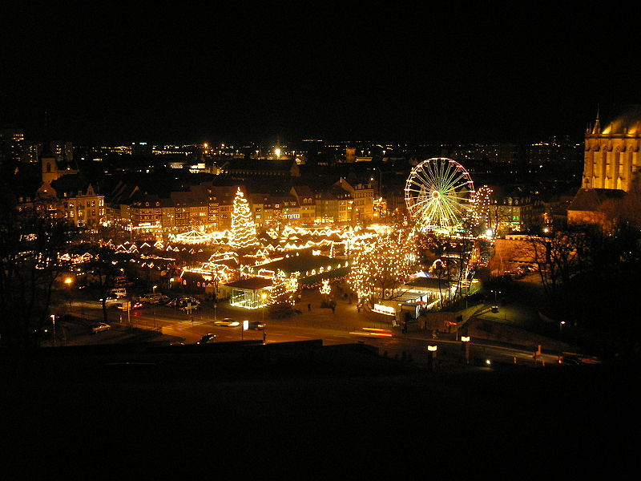
Christmas markets
A Christmas market, also known as Christkindlmarkt, Christkindlesmarkt, Christkindlmarket, and Weihnachtsmarkt, is a street market associated with the celebration of Christmas during the four weeks of Advent. These markets originated in Germany, Austria and Alsace but are now being held in many other countries.
The history of Christmas markets goes back to the Late Middle Ages in the German speaking part of Europe. The Dresden Christmas market, first held in 1434, is one of the oldest Christmas markets. It attracts between 1.5 and 2 million visitors a year and has over 250 stalls. The Bautzen Christmas market was even older, first being mentioned in records in 1384. The Vienna "December market" was a kind of forerunner of the Christmas market and dates back to 1294

Slide 18
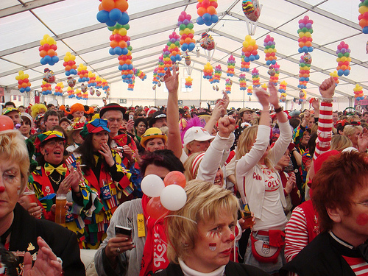
Carnival
Carnival is a festive season which occurs immediately before Lent; the main events are usually during February. Carnival typically involves a public celebration or parade combining some elements of a circus, mask and public street party. People often dress up or masquerade during the celebrations, which mark an overturning of daily life

Slide 19
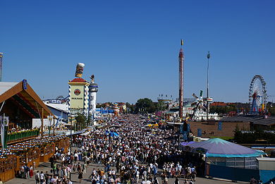
Oktoberfest
Oktoberfest is a 16-18 day festival held each year in Munich, Bavaria, Germany, running from late September to the first weekend in October. It is one of the most famous events in Germany and the world's largest fair, with more than 5 million people attending every year. The Oktoberfest is an important part of Bavarian culture. Other cities across the world also hold Oktoberfest celebrations, modeled after the Munich event. The Munich Oktoberfest, traditionally, takes place during the sixteen days up to and including the first Sunday in October. In 1994, the schedule was modified in response to German reunification so that if the first Sunday in October falls on the 1st or 2nd, then the festival will go on until October 3. Thus, the festival is now 17 days when the first Sunday is October 2 and 18 days when it is October 1. In 2010, the festival lasts until the first Monday in October, to mark the 200-year anniversary of the event. The festival is held in an area named the Theresienwiese often called Wiesn for short, located near Munich's centre.

Slide 20
Swell
www.wikipedia.de
www.Google.de
www.Google.de/Bilder
Germany book

Slide 21
Power Point Presentation
produced by Zita Mohr
for the COMENIUS - PROJECT
at IGS Busecker Tal

